Slide 1


Advanced DS
Data Structure and Algorithms
Fall 2025
Binary Search Tree
eduko.spikotech.com
University of Engineering and Technology Lahore Pakistan

Slide 2
Binary Search Tree
Course Reference: CS161 by Stanford

Slide 3
Some data structures for storing objects like (aka, nodes with keys)
5
(Sorted) arrays:
Linked lists:
Some basic operations:
INSERT, DELETE, SEARCH
1
2
3
4
5
7
8
3
2
1
8
5
7
4
HEAD

Slide 4
Sorted Arrays
1
2
3
4
5
7
8
O(n) INSERT/DELETE:
First, find the relevant element (we’ll see how below), and then move a bunch elements in the array:
O(log(n)) SEARCH:
1
2
3
4
4.5
8
5
7
eg, insert 4.5
1
2
3
4
5
7
8
eg, Binary search to see if 3 is in A.

Slide 5
(Not necessarily sorted) Linked lists
7
5
3
4
1
2
8
O(1) INSERT:
O(n) SEARCH/DELETE:
eg, insert 6
7
5
3
4
1
2
8
HEAD
6
7
5
3
4
1
2
8
HEAD
eg, search for 1 (and then you could delete it by manipulating pointers).

Slide 6
Motivation for Binary Search Trees
TODAY!
 | Sorted Arrays | Linked Lists | Binary Search Trees
Search | O(log(n)) | O(n) | O(log(n))
Delete | O(n) | O(n) | O(log(n))
Insert | O(n) | O(1) | O(log(n))
(Balanced)

Slide 7
Binary tree terminology
For today all keys are distinct.
This is a node.
It has a key (7).
Each node has two children.
This node is the root
The left child of is
5
3
2
The right child of is
3
4
3
7
5
The parent of is
3
2
5
is a descendant of
2
4
8
Each node has a pointer to its left child, right child, and parent.
1
Both children of are NIL.
(I won’t usually draw them).
1
These nodes are leaves.
The height of this tree is 3. (Max number of edges from the root to a leaf).
NIL
NIL

Slide 8
Binary Search Trees
From your pre-lecture exercise…
A BST is a binary tree so that:
Every LEFT descendant of a node has key less than that node.
Every RIGHT descendant of a node has key larger than that node.
Example of building a binary search tree:
3
4
5
8
7
1
2

Slide 9
Binary Search Trees
A BST is a binary tree so that:
Every LEFT descendant of a node has key less than that node.
Every RIGHT descendant of a node has key larger than that node.
Example of building a binary search tree:
3
4
5
8
7
1
2

Slide 10
Binary Search Trees
A BST is a binary tree so that:
Every LEFT descendant of a node has key less than that node.
Every RIGHT descendant of a node has key larger than that node.
Example of building a binary search tree:
5
3
1
4
7
2
8

Slide 11
Binary Search Trees
A BST is a binary tree so that:
Every LEFT descendant of a node has key less than that node.
Every RIGHT descendant of a node has key larger than that node.
Example of building a binary search tree:
5
3
7
1
2
4
8

Slide 12
Binary Search Trees
A BST is a binary tree so that:
Every LEFT descendant of a node has key less than that node.
Every RIGHT descendant of a node has key larger than that node.
Example of building a binary search tree:
5
Q: Is this the only binary search tree I could possibly build with these values?
3
7
A: No. I made choices about which nodes to choose when. Any choices would have been fine.
2
4
8
1

Slide 13
Aside: this should look familiar
kinda like QuickSort
3
4
5
8
7
1
2

Slide 14
Binary Search Trees
Which of these is a BST?
1 minute Think-Pair-Share
A BST is a binary tree so that:
Every LEFT descendant of a node has key less than that node.
Every RIGHT descendant of a node has key larger than that node.
5
5
3
7
3
7
2
4
8
2
4
8
NOT a Binary Search Tree
1
Binary Search Tree
1

Slide 15
Aside: In-Order Traversal of BSTs
Output all the elements in sorted order!
inOrderTraversal(x):
if x!= NIL:
inOrderTraversal( x.left )
print( x.key )
inOrderTraversal( x.right )
5
3
7
2
4

Slide 16
Aside: In-Order Traversal of BSTs
Output all the elements in sorted order!
inOrderTraversal(x):
if x!= NIL:
inOrderTraversal( x.left )
print( x.key )
inOrderTraversal( x.right )
5
3
7
2
4

Slide 17
Aside: In-Order Traversal of BSTs
Output all the elements in sorted order!
inOrderTraversal(x):
if x!= NIL:
inOrderTraversal( x.left )
print( x.key )
inOrderTraversal( x.right )
5
3
7
2
4
NIL
NIL

Slide 18
Aside: In-Order Traversal of BSTs
Output all the elements in sorted order!
inOrderTraversal(x):
if x!= NIL:
inOrderTraversal( x.left )
print( x.key )
inOrderTraversal( x.right )
5
3
7
2
4
NIL
NIL

Slide 19
Aside: In-Order Traversal of BSTs
Output all the elements in sorted order!
inOrderTraversal(x):
if x!= NIL:
inOrderTraversal( x.left )
print( x.key )
inOrderTraversal( x.right )
5
3
7
2
4
NIL
NIL
2

Slide 20
Aside: In-Order Traversal of BSTs
Output all the elements in sorted order!
inOrderTraversal(x):
if x!= NIL:
inOrderTraversal( x.left )
print( x.key )
inOrderTraversal( x.right )
5
3
7
2
4
NIL
NIL
2

Slide 21
Aside: In-Order Traversal of BSTs
Output all the elements in sorted order!
inOrderTraversal(x):
if x!= NIL:
inOrderTraversal( x.left )
print( x.key )
inOrderTraversal( x.right )
5
3
7
2
4
NIL
NIL
2

Slide 22
Aside: In-Order Traversal of BSTs
Output all the elements in sorted order!
inOrderTraversal(x):
if x!= NIL:
inOrderTraversal( x.left )
print( x.key )
inOrderTraversal( x.right )
5
3
7
2
4
2
3

Slide 23
Aside: In-Order Traversal of BSTs
Output all the elements in sorted order!
inOrderTraversal(x):
if x!= NIL:
inOrderTraversal( x.left )
print( x.key )
inOrderTraversal( x.right )
5
3
7
2
4
2
3
4

Slide 24
Aside: In-Order Traversal of BSTs
Output all the elements in sorted order!
inOrderTraversal(x):
if x!= NIL:
inOrderTraversal( x.left )
print( x.key )
inOrderTraversal( x.right )
5
3
7
2
4
2
3
4

Slide 25
Aside: In-Order Traversal of BSTs
Output all the elements in sorted order!
inOrderTraversal(x):
if x!= NIL:
inOrderTraversal( x.left )
print( x.key )
inOrderTraversal( x.right )
5
3
7
2
4
2
3
4
5

Slide 26
Aside: In-Order Traversal of BSTs
Output all the elements in sorted order!
inOrderTraversal(x):
if x!= NIL:
inOrderTraversal( x.left )
print( x.key )
inOrderTraversal( x.right )
5
3
7
2
4
2
3
4
5
7

Slide 27
Aside: In-Order Traversal of BSTs
Output all the elements in sorted order!
inOrderTraversal(x):
if x!= NIL:
inOrderTraversal( x.left )
print( x.key )
inOrderTraversal( x.right )
5
3
7
2
4
Runs in time O(n).
2
3
4
5
7
Sorted!

Slide 28
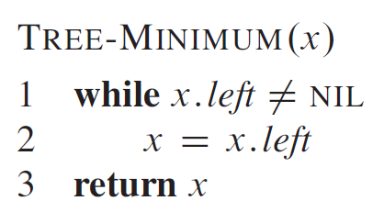
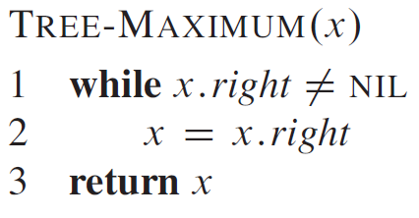
Tree Minimum and Tree Maximum
5
3
7
2
4
8
1

Slide 29
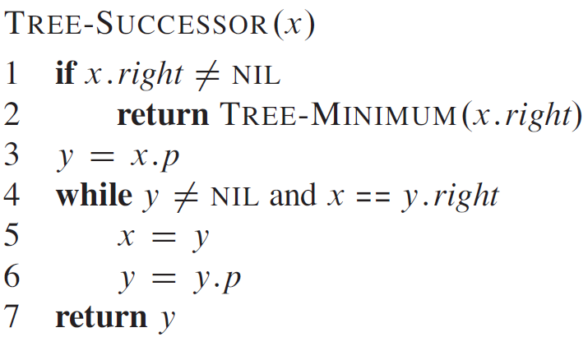
Tree Successor
5
3
7
2
4
8
1

Slide 30
Tree Predecessor
5
3
7
2
4
8
1

Slide 31
Back to the goal
Fast SEARCH/INSERT/DELETE
Can we do these?

Slide 32
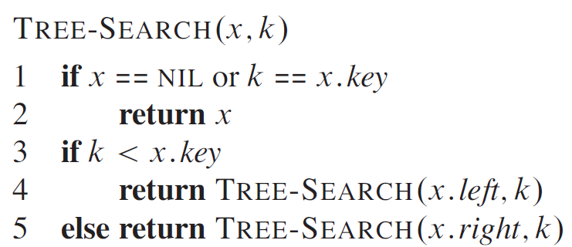
SEARCH in a Binary Search Tree definition by example
EXAMPLE: Search for 4.
5
EXAMPLE: Search for 4.5
It turns out it will be convenient to return 4 in this case
(that is, return the last node before we went off the tree)
3
7
!!!!
2
4
8
Write pseudocode (or actual code) to implement this!
1
How long does this take?
O(length of longest path) = O(height)
Ollie the over-achieving ostrich

Slide 33
INSERT in a Binary Search Tree
EXAMPLE: Insert 4.5
5
INSERT(key):
x = SEARCH(key)
Insert a new node with desired key at x…
3
7
!!!!
2
4
8
x =
4
1
4.5

Slide 34
INSERT in a Binary Search Tree
EXAMPLE: Insert 4.5
5
INSERT(key):
x = SEARCH(key)
if key > x.key:
Make a new node with the correct key, and put it as the right child of x.
if key < x.key:
Make a new node with the correct key, and put it as the left child of x.
if x.key == key:
return
3
7
!!!!
2
4
8
x =
4
1
4.5

Slide 35
DELETE in a Binary Search Tree
EXAMPLE: Delete 2
DELETE(key):
x = SEARCH(key)
if x.key == key:
….delete x….
5
3
7
2
4
8
x =
2
1

Slide 36
DELETE in a Binary Search Tree several cases (by example) say we want to delete 3
5
5
5
5
3
3
2
Case 1: if 3 is a leaf,
just delete it.
2
This triangle is a cartoon for a subtree
Write pseudocode for all of these!
Case 2: if 3 has just one child,
move that up.
Siggi the Studious Stork

Slide 37
DELETE in a Binary Search Tree ctd.
Case 3: if 3 has two children,
replace 3 with it’s immediate successor.
(aka, next biggest thing after 3)
Does this maintain the BST property?
Yes.
How do we find the immediate successor?
SEARCH for 3 in the subtree under 3.right
How do we remove it when we find it?
If [3.1] has 0 or 1 children, do one of the previous cases.
What if [3.1] has two children?
It doesn’t.
5
5
3
3.1
2
4
2
4
3.1

Slide 38
How long do these operations take?
SEARCH is the big one.
Everything else just calls SEARCH and then does some small O(1)-time operation.
5
Time = O(height of tree)
3
7
Trees have depth O(log(n)). Done!
Wait a second…
2
4
6
8
How long does search take?
1 minute think; 1 minute pair+share
Lucky the lackadaisical lemur.
Plucky the Pedantic Penguin

Slide 39
Search might take time O(n).
2
This is a valid binary search tree.
The version with n nodes has depth n, not O(log(n)).
3
4
5
6
7
8

Slide 40
What to do?
How often is “every so often” in the worst case? It’s actually pretty often!
Ollie the over-achieving ostrich
Goal: Fast SEARCH/INSERT/DELETE
All these things take time O(height)
And the height might be big!!! ☹
Idea 0:
Keep track of how deep the tree is getting.
If it gets too tall, re-do everything from scratch.
At least Ω(n) every so often….

